Slide 1
Portrayals of Masculinity in men’s lifestyle magazines
By: Nate Gilbert

Slide 2
Abstract
Analysis of eight different men’s lifestyle magazines circulated in Canada
Purpose was to look at how masculinities were being shown in regards to body, aesthetics and grooming, and fashion
Wanted to see how many and what types of hegemonic masculinity existed and whether they were similar with previous forms

Slide 3
Hegemonic masculinity
Hegemonic masculinity represents culturally normative and influential ideals of masculinity.
Characteristics of hegemonic masculinity include strength, size, power and authority.
It is a benchmark that most men are unable to attain.

Slide 4
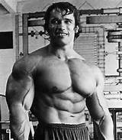
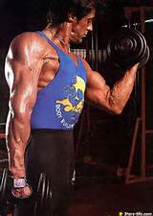
Muscularity
The evolution of muscularity
People who best fulfill the modern definition of muscularity

Slide 5
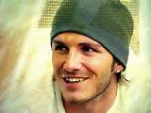
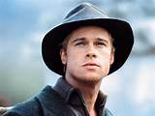
Metrosexuality
Metrosexuality which began in the 1970’s focuses on self-appearance, self-presentation and grooming.
Evolved due to the increase in grooming products and expendable incoming of a single man.

Slide 6
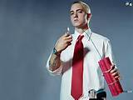
LAddism
Laddism emerged in the United Kingdom in the 1990’s.
It can be characterized by being youthful, a bachelor, and objectifying women.

Slide 7
The medias role
Prior to 1995, media images of men have focuses on the face rather than the body.
Media representations have led men to become more responsible for the shape and size of their body.

Slide 8
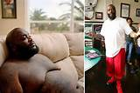
The male Body
All magazines contained inspiration stories involving weight lost. Many of which involved famous celebrities
The male body was displayed in all of these magazines which indicates it is a very visible part to our society

Slide 9
Aesthetics and grooming
“You are how you groom. Behind every blinding smile, careful coiffure, and neatly trimmed nostril fringe lays the daily routine that defines you. The way you leave the bathroom says a lot about how you’ll tackle each day…Good grooming has the power to make you a better man…start grooming for improvement”

Slide 10
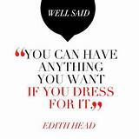
Fashion
Fashion played a large role in all of these magazines. Despite showing different fashions to directly relate to their audience it was quite evident that image, style and appearance was important for the modern man.
There were many instances that said something to the like of ‘dress the part’ is essential for success it whatever you are doing whether it be sports, work , or social life.

Slide 11
conclusion
All of the magazines looked at represent hegemonic masculinity in different ways.
Hegemonic masculinity remains dominant due to its ability to change with the times and emerge into new forms of masculinity.
It was clear that male body images are ever changing and becoming more sexualized.
Men are more responsible for their personal appearance.

Slide 12
How article relates to course topics
Men are feeling some of the same pressures as women from the media.
Advertisers target products to men and women that they say if used can make them more attractive and desirable.
Through this article it is apparent that masculinity is changing much like the ways we view gender is transforming.

Slide 13
Reaction and limitations
The research done was close to 10 years ago.
It surveyed lifestyle magazines sold in Canada, not the United States.
The authors went really in depth with the research to try and find the most relevant data.

Slide 14
Discussion questions
Do you think it is good or bad there is an ever growing usage of the male body in many forms of media?
How can people stop feeling the pressure put on them by magazines or media to look or feel a certain way?

